Slide 1
Caledonia Tech University Database
Group Members:
Justin Williams
Aaron Brown
Hope Bounds
Courtnae James

Slide 2
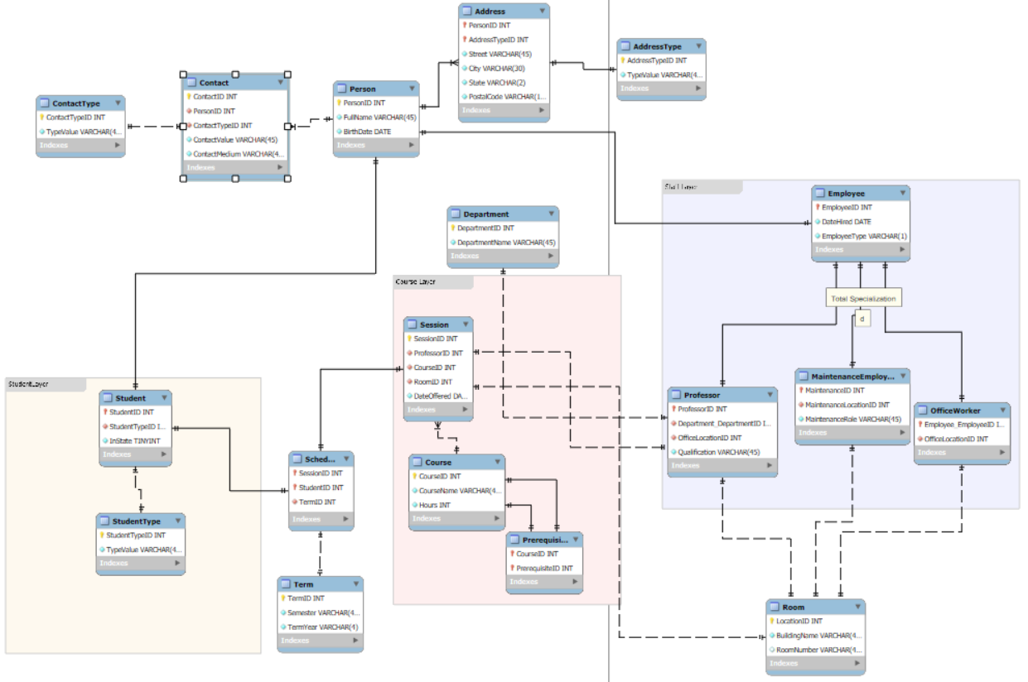
EER Diagram

Slide 3
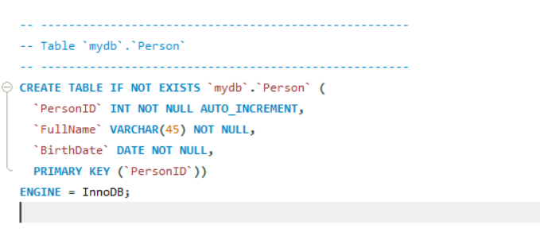
Person Table

Slide 4
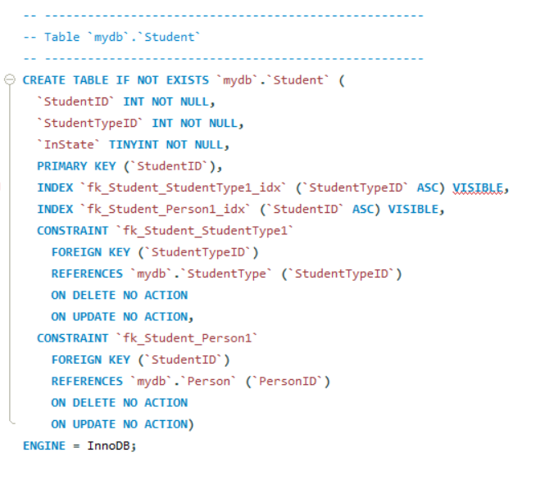
Student

Slide 5
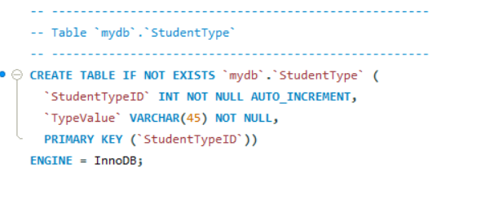
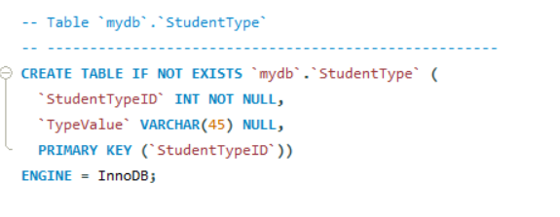
DDL- Student Type Table

Slide 6
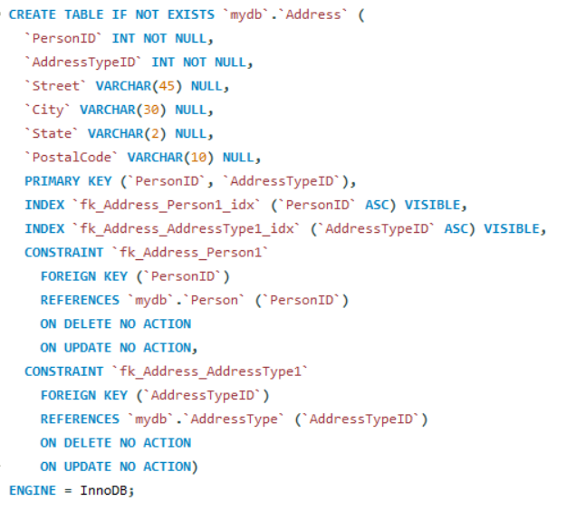
Address

Slide 7
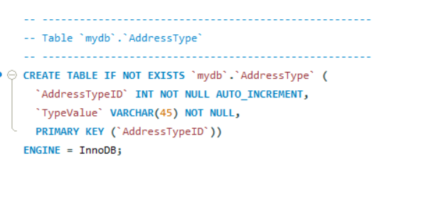
Address Type

Slide 8
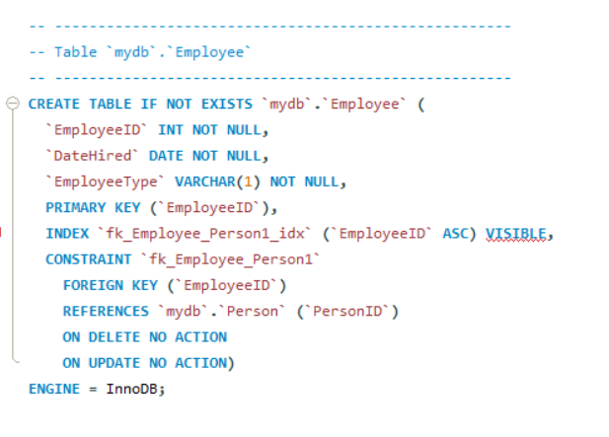
Employee

Slide 9
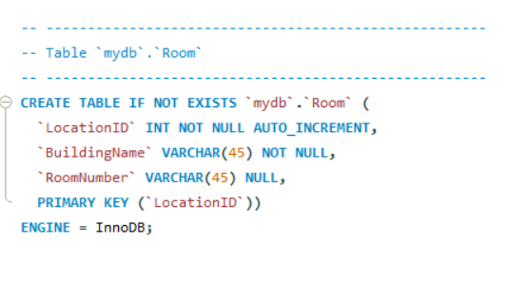
Room

Slide 10
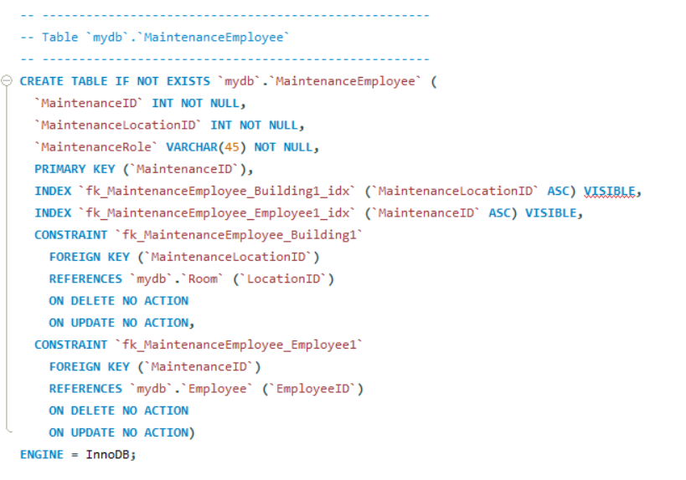
Maintenance Employee

Slide 11
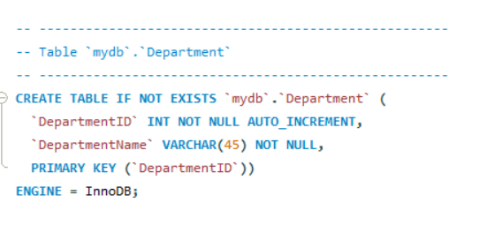
Department

Slide 12
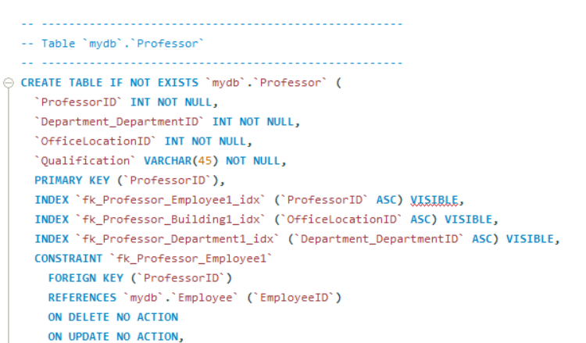
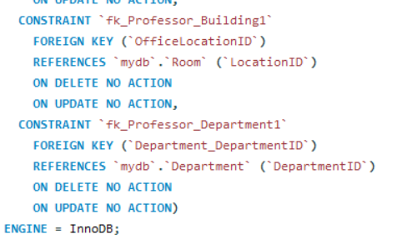
Professor

Slide 13
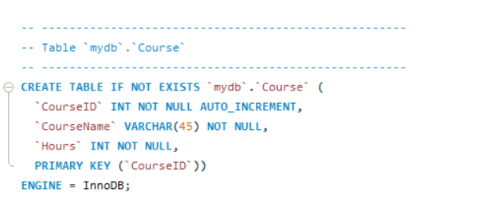
Course

Slide 14
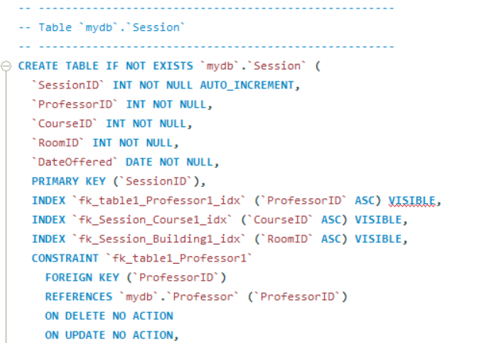
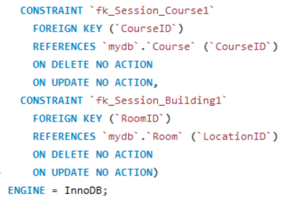
Session

Slide 15
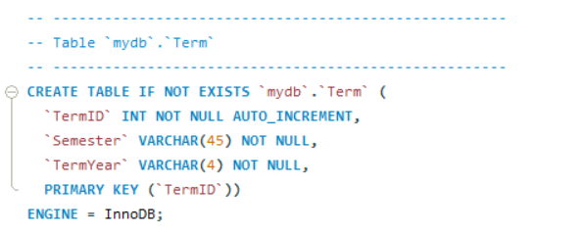
Term

Slide 16
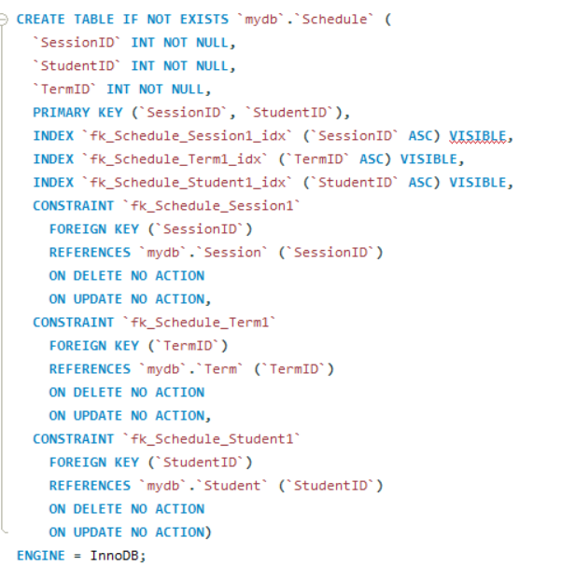
Schedule

Slide 17
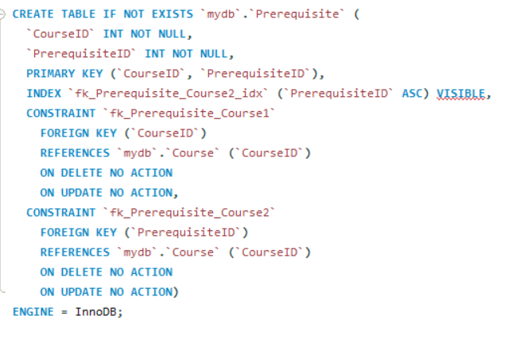
Prerequisite

Slide 18
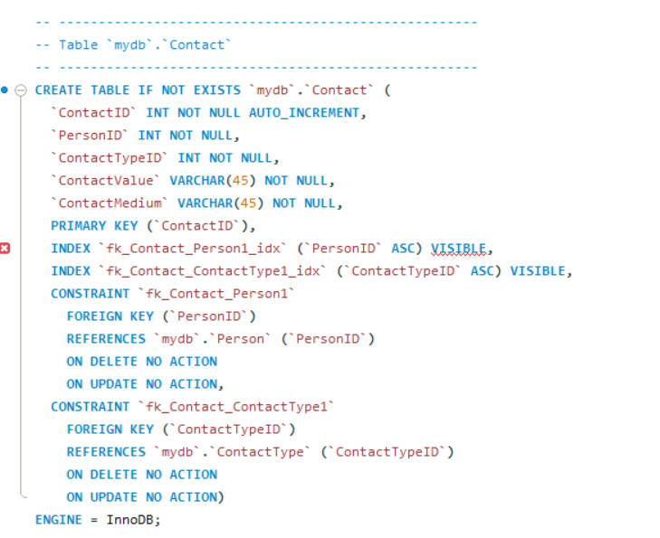
Contact

Slide 19
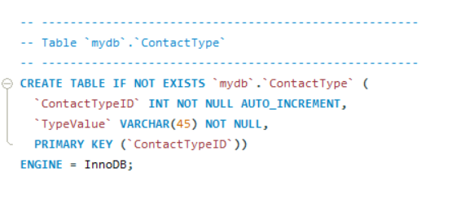
Contact Type

Slide 20
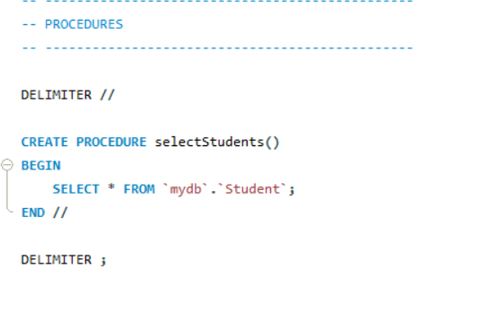
PROCEDURES

Slide 21
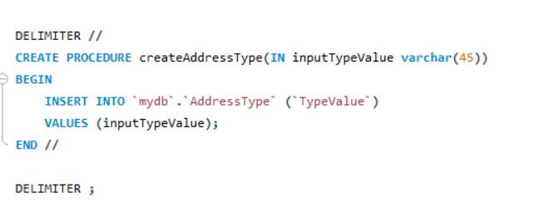

Slide 22
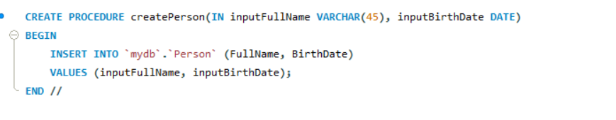

Slide 23
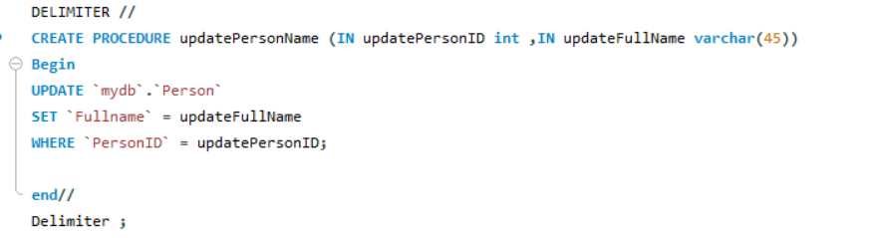

Slide 24
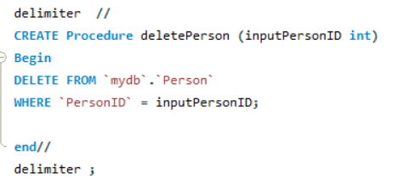

Slide 25
ORM Language We Chose: Python
Python is widely regarded as the best language for data science due to its simplicity, libraries, and community support.
Additionally, the software development team is comfortable and experienced with Python.
ORM Options Considered:
SQLAlchemy: Powerful, flexible ORM for both small and large apps.
Django ORM: Ideal for Django web projects.
PeeWee: Lightweight ORM for small apps.
Pony ORM: ORM with Python generators for easy queries.
SQLObject: Simple ORM for small applications.
Gino: Async ORM built on SQLAlchemy.

Slide 26
Why We Chose SQLAlchemy
We selected SQLAlchemy as our ORM framework due to the following reasons:
Team Experience:
Our development team has prior experience with SQLAlchemy.
Flexibility:
Well-suited for both small-scale and enterprise-level applications.
Community Support:
The most popular Python ORM, with a large community and extensive documentation.
Source: github.com/vajol/python-data-engineering-resources/blob/main/resources/orms-for-python.md

Slide 27
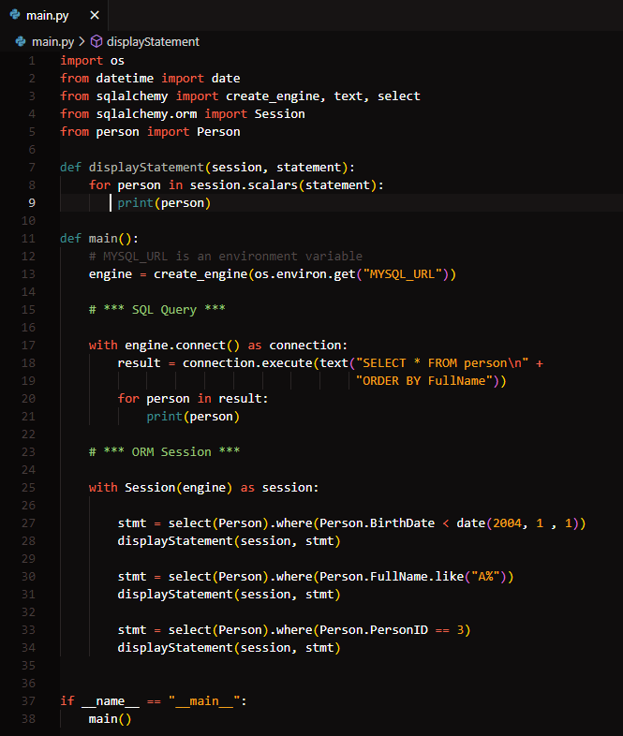
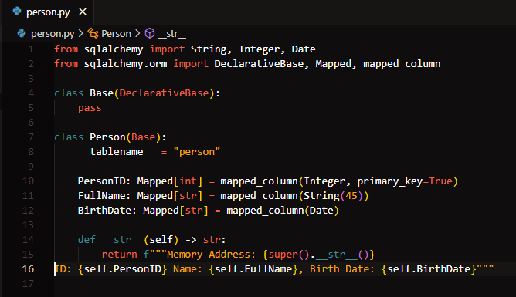
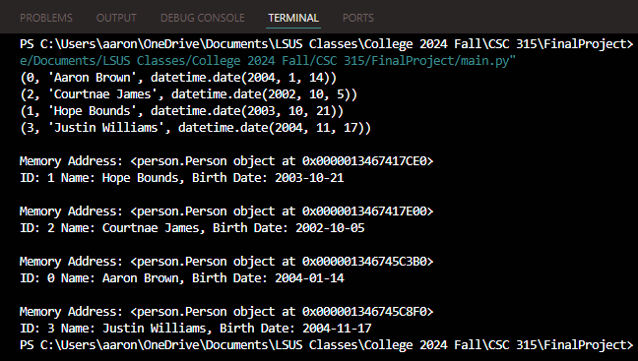
ORM code

